Slide 1
WELCOME TO OUR PRESENTATION

Slide 2
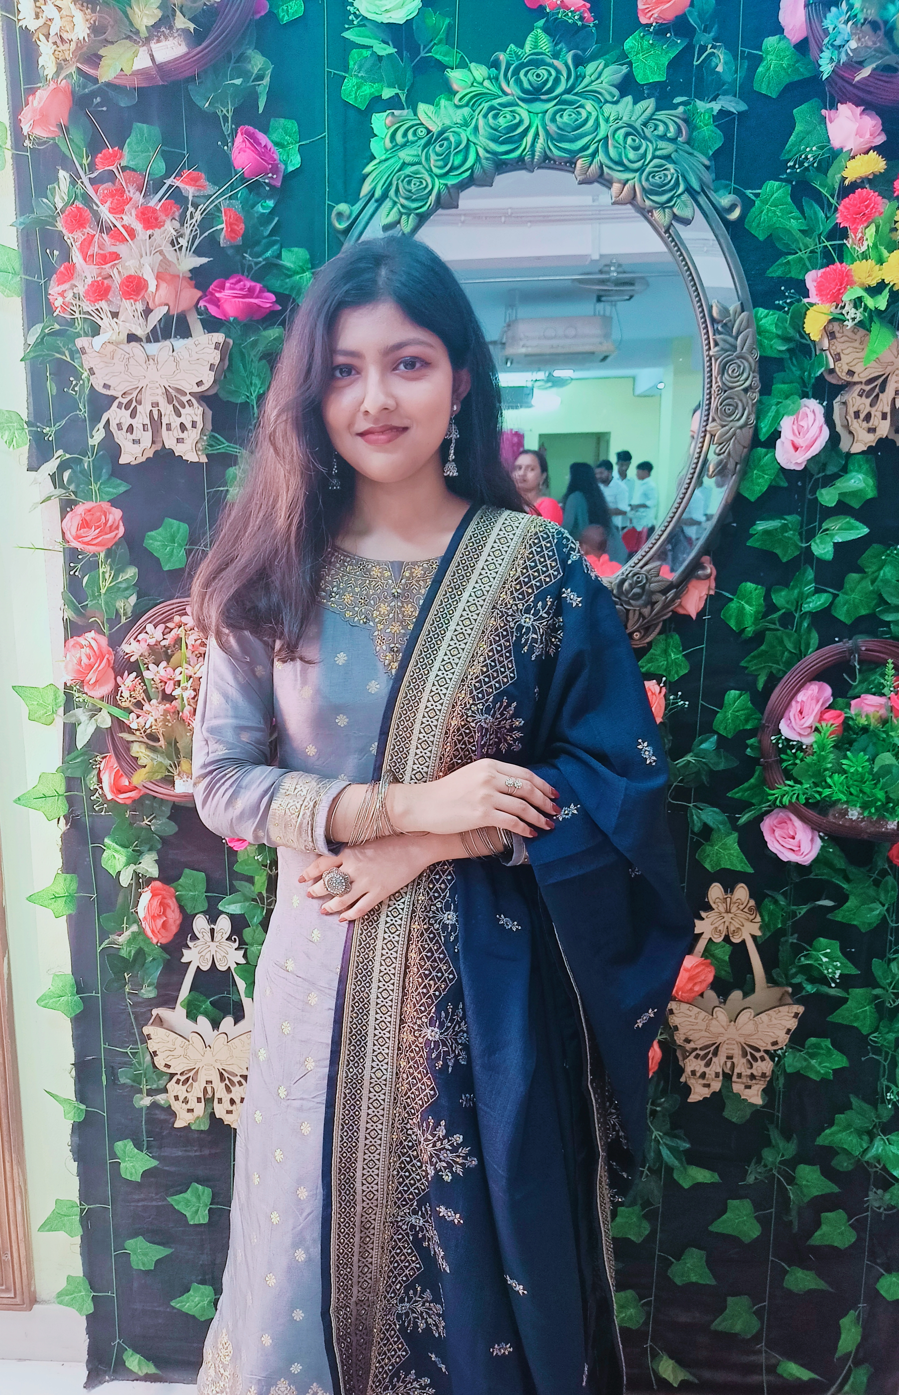

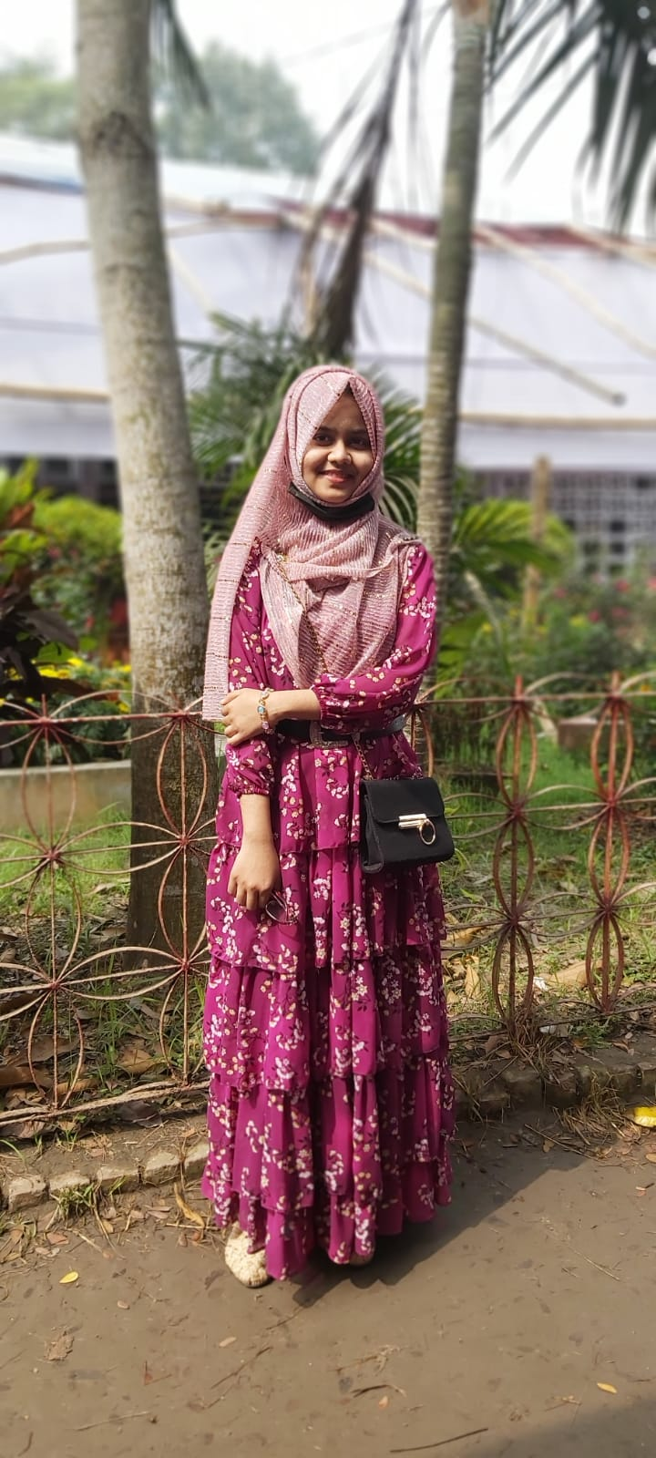
Our team
Esha Saha
Akash Biswas
Nuzhat Tasnim
Roll no: 2107079
Roll no: 2107013
Roll no: 2107082

Slide 3
Project Name
Student Hall Management System

Slide 4
We developed a project on student hall management system for a university in six departments (CSE,EEE,CE,ME,URP,ARCH) . The system allows hall manager to manage student records , hall staff records and student meal records including appropriate functionalities . The project has student class with attributes student name ,ID , roomnumber,department,hall due and a boolean variable HalldueStatus .A staff class that contains three attributes staff name , ID and position of the staff and a meal class containing student name ,student ID,date1,date2 and MealOnStatus as attributes.These three class have some member function and constructor those are created as per our requirements .The last one is hallmanager class.As attributes ,the class has three array of student, staff and meal class type and two integer variable carrying total number of student and staff present in this hall. It also includes a friend function. The hallmanager class has the following functionalities:

Slide 5
Contents of this Project
1. A method to add a new student. | 7. A method to turn on meal.
2. A method to remove a student from this hall. | 8. A method to turn off meal.
3. A method to display all student. | 9. A method to display meal details.
4. A method to set halldue . | 10. A method to add new staff.
5. A method to pay off halldue . | 11. A method to display all staff.
6. A method to display halldue of a student. | 12. A method to search a student.

Slide 6
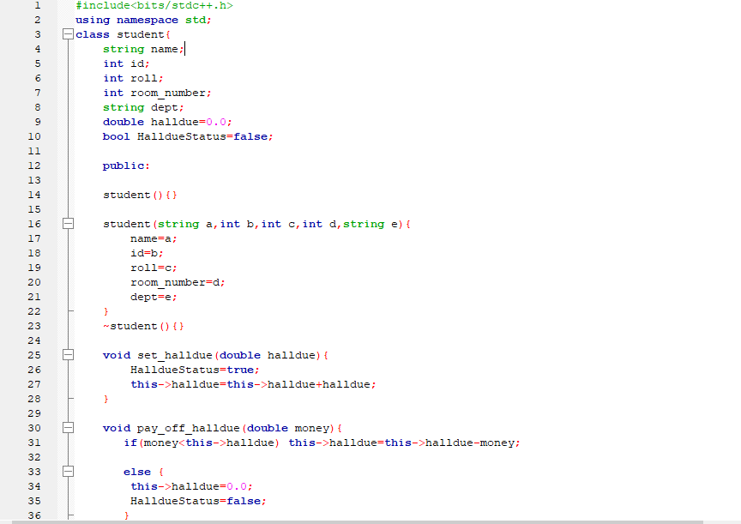

Code of 2107079 :
Class 1

Slide 7
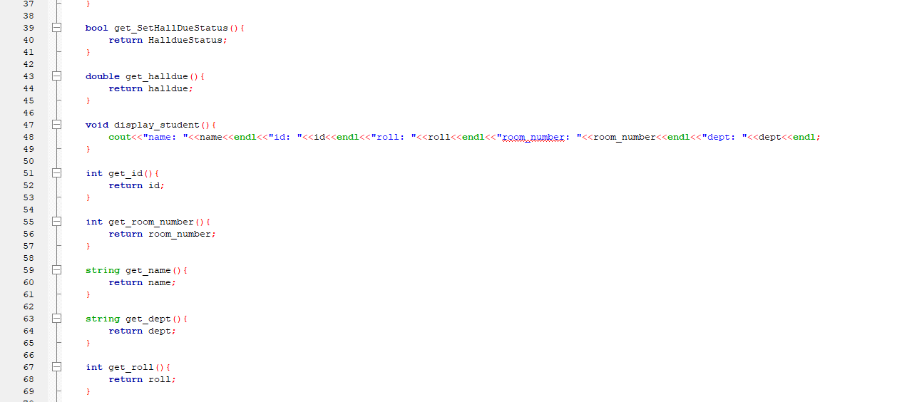

Slide 8
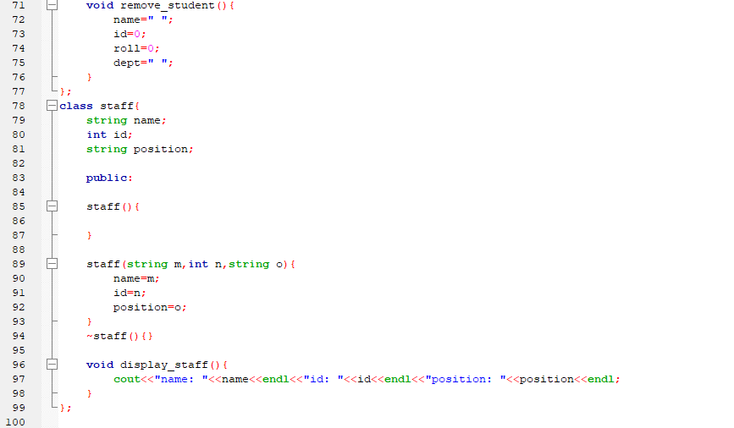
Class 2

Slide 9
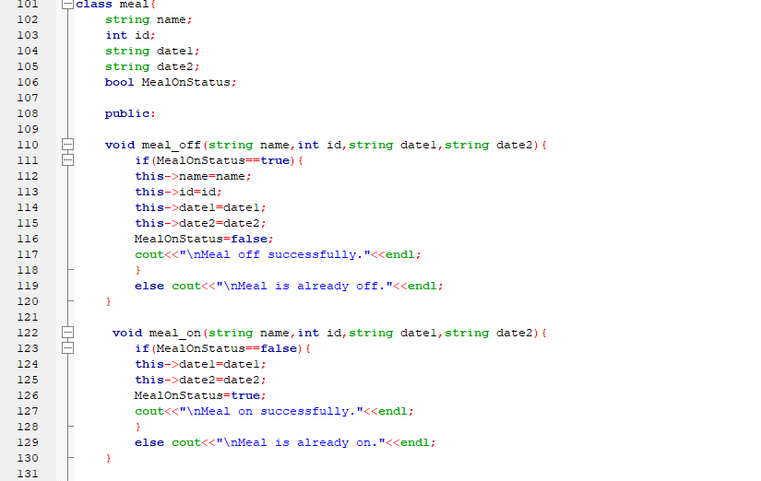
Class 3

Slide 10
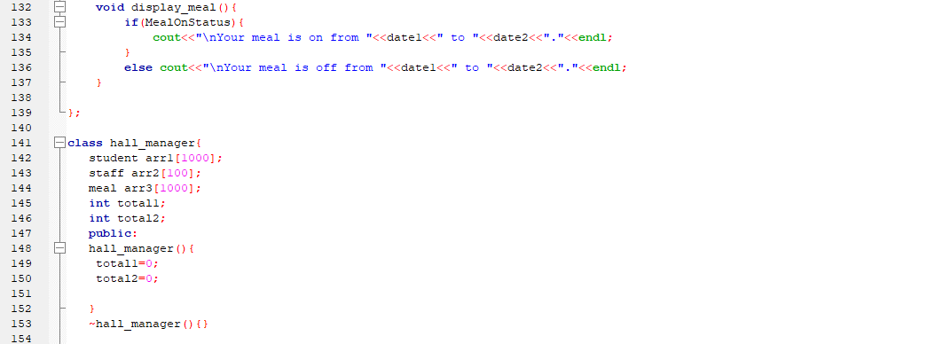
Class 4

Slide 11
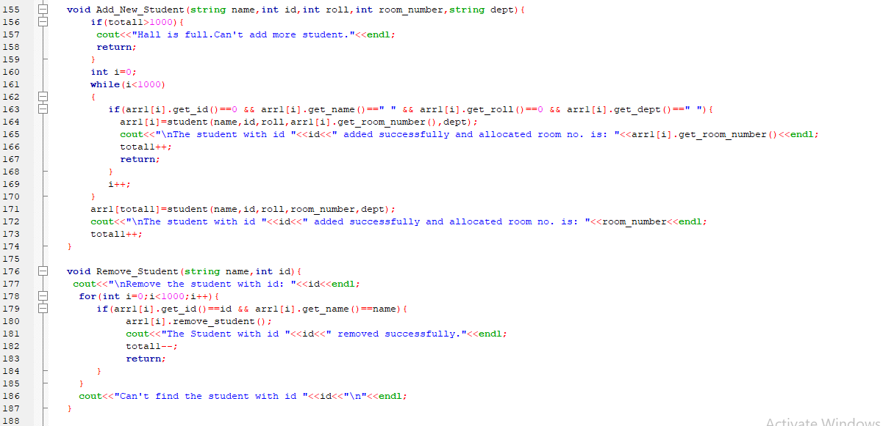

Slide 12
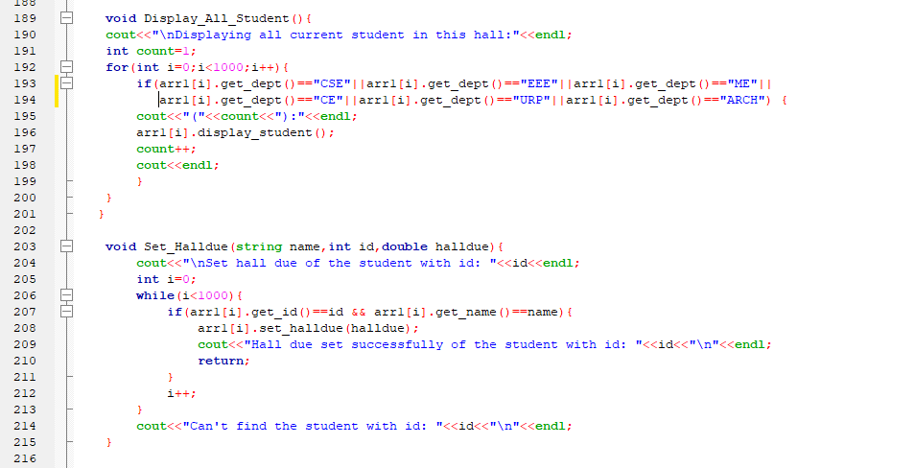

Slide 13
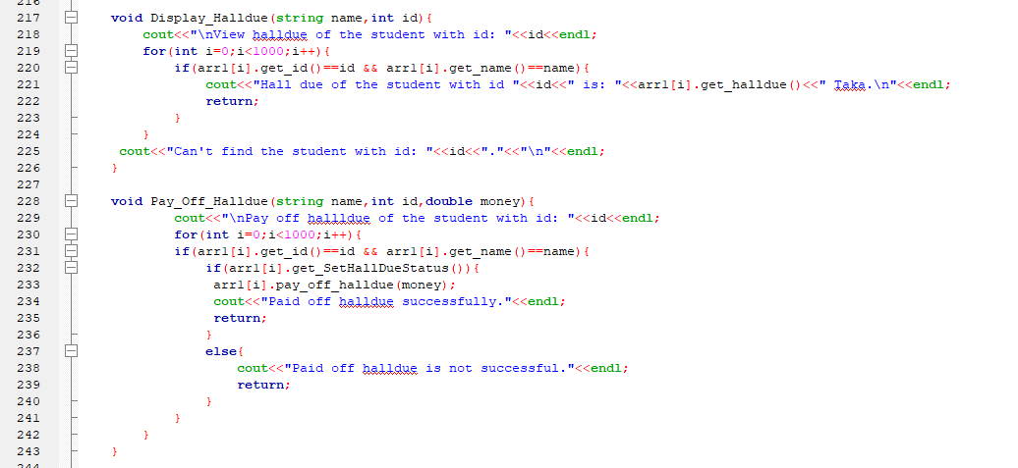

Slide 14
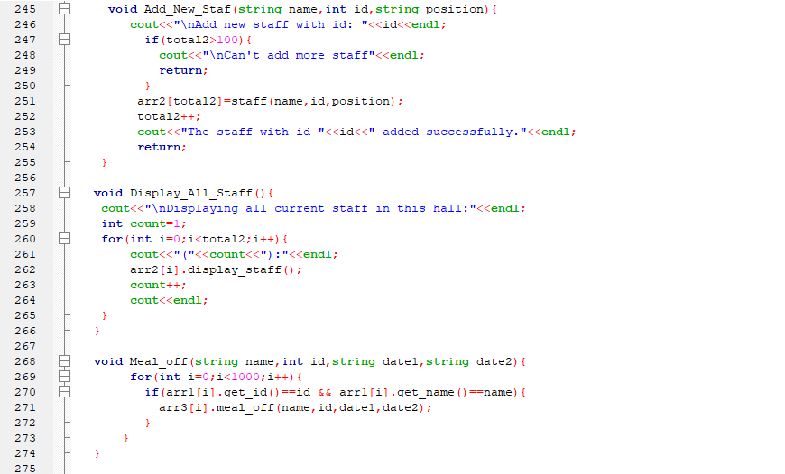

Slide 15
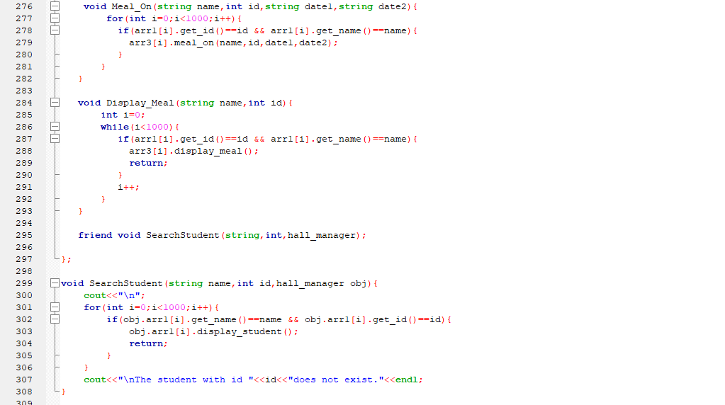
Friend Function

Slide 16
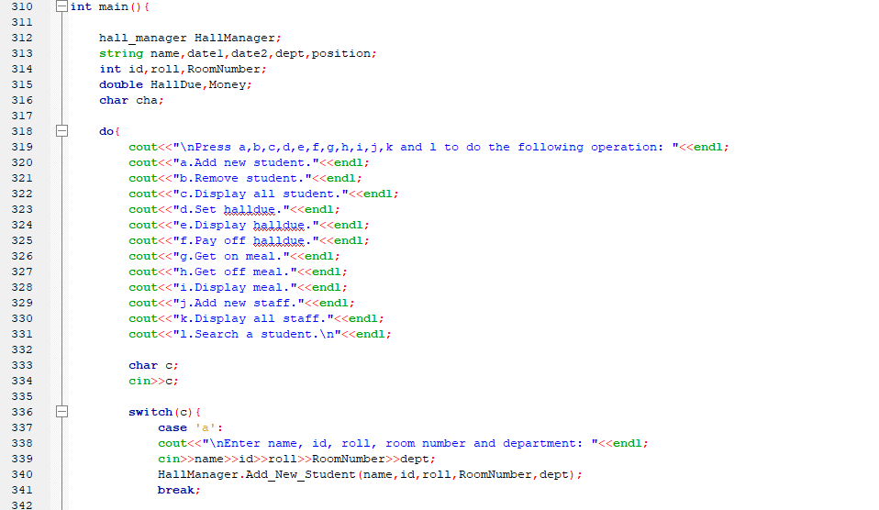

Slide 17
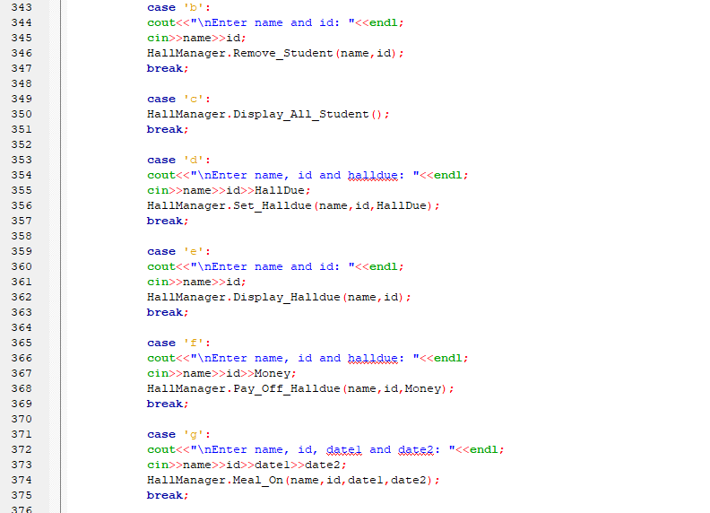

Slide 18
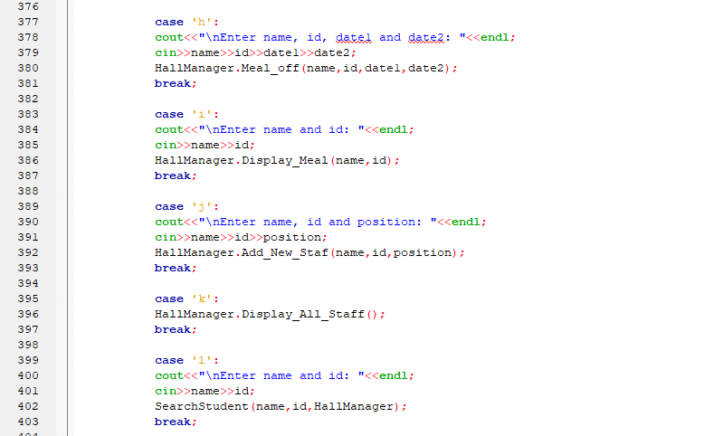

Slide 19
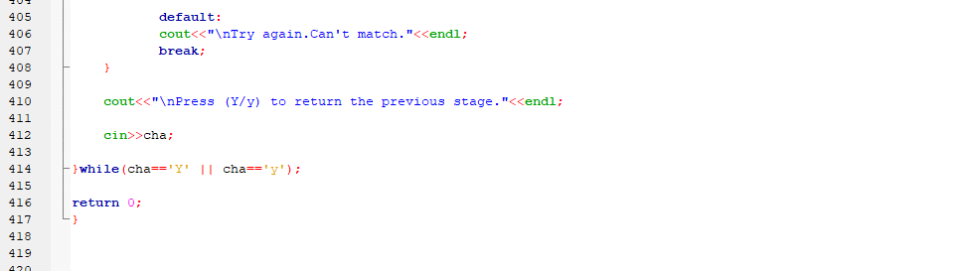

Slide 20
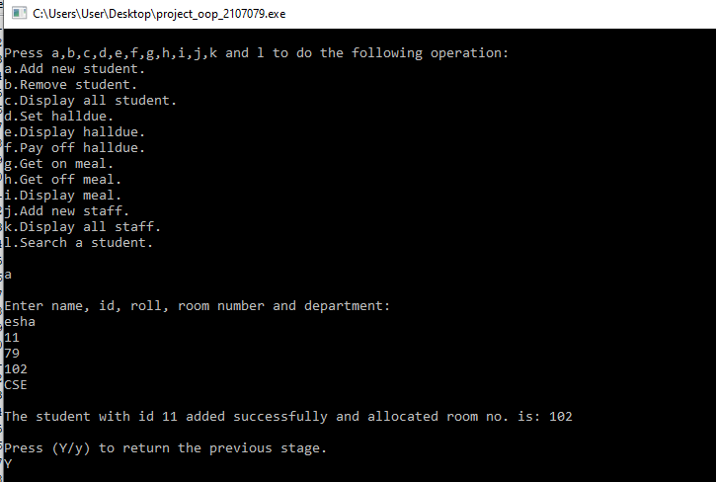
Output :

Slide 21
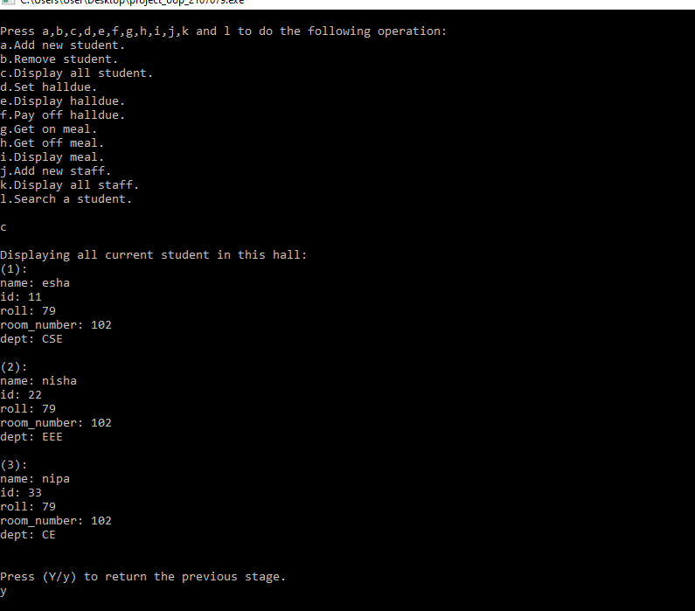

Slide 22
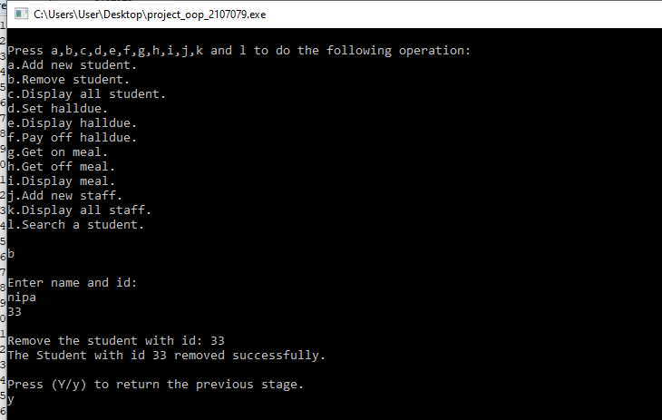

Slide 23
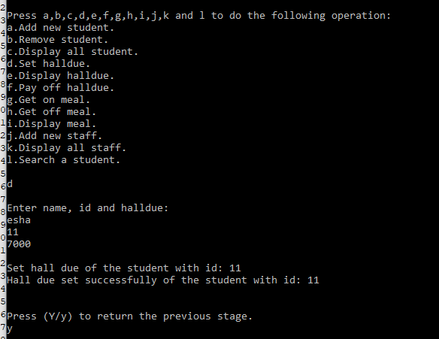

Slide 24
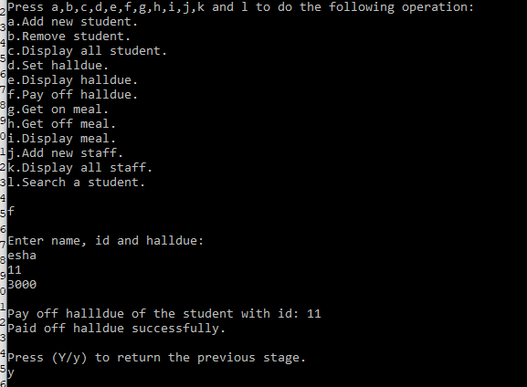

Slide 25
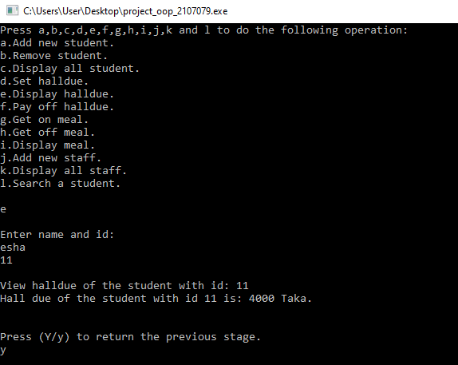

Slide 26
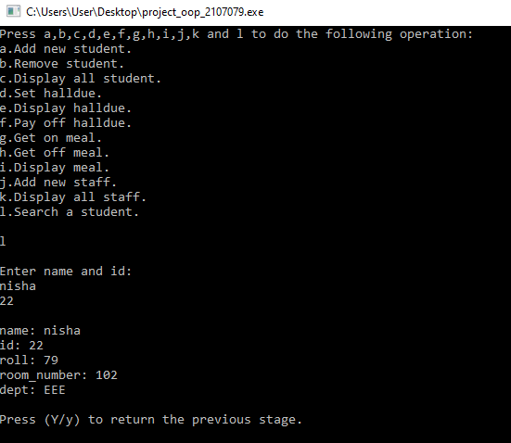

Slide 27
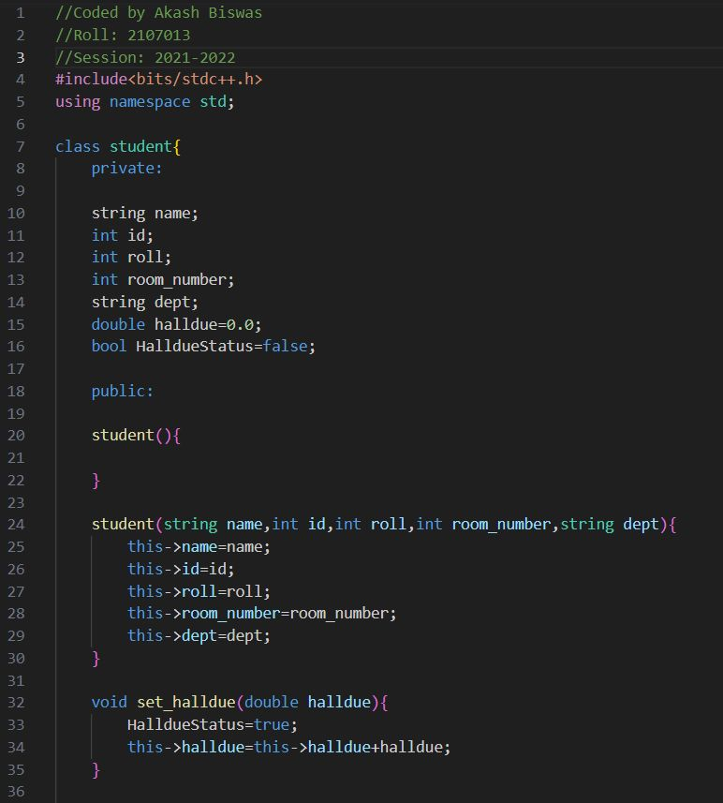
Code of 2107013 :
Class 1

Slide 28
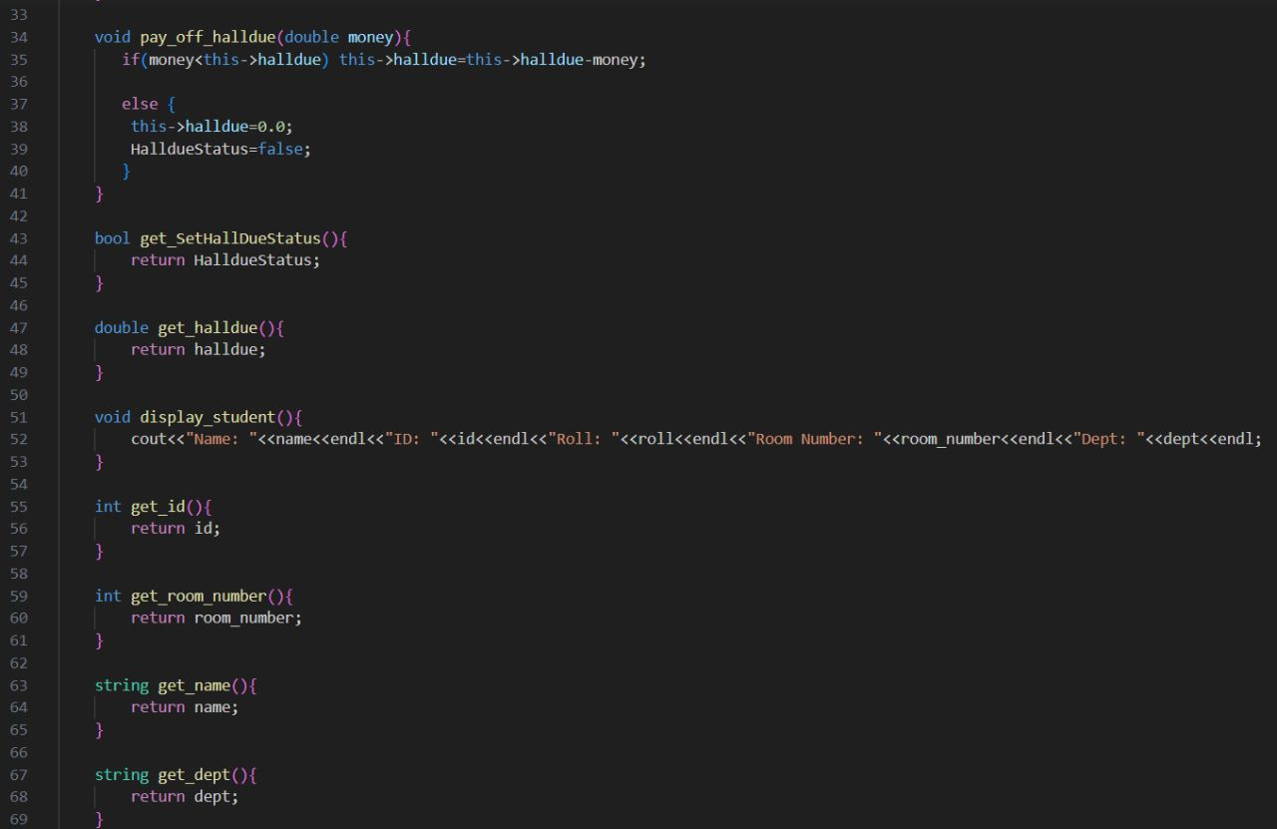

Slide 29
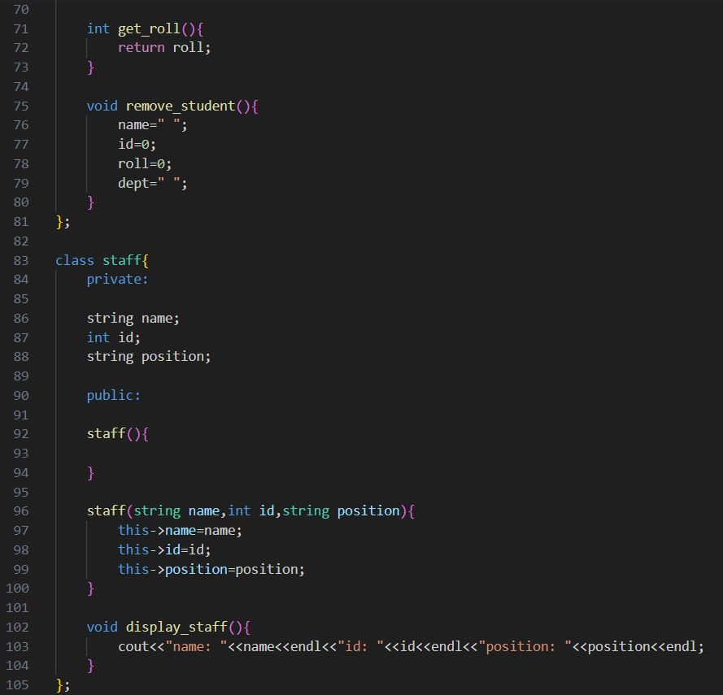
Class 2

Slide 30
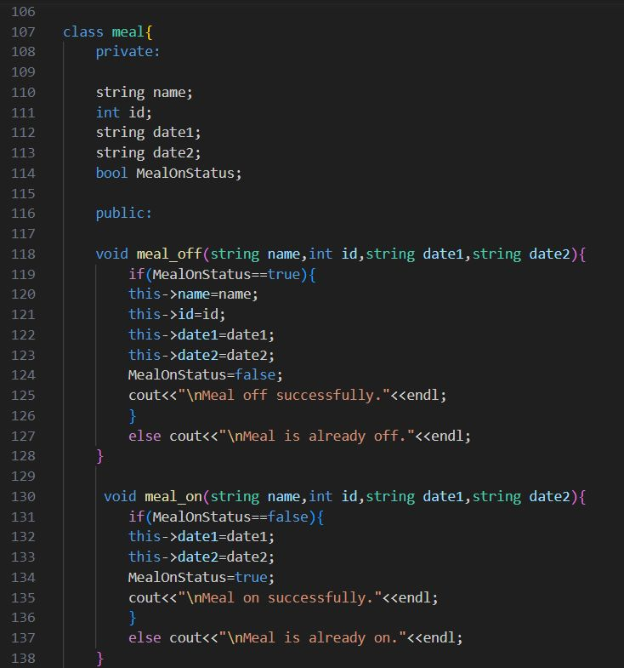
Class 3

Slide 31
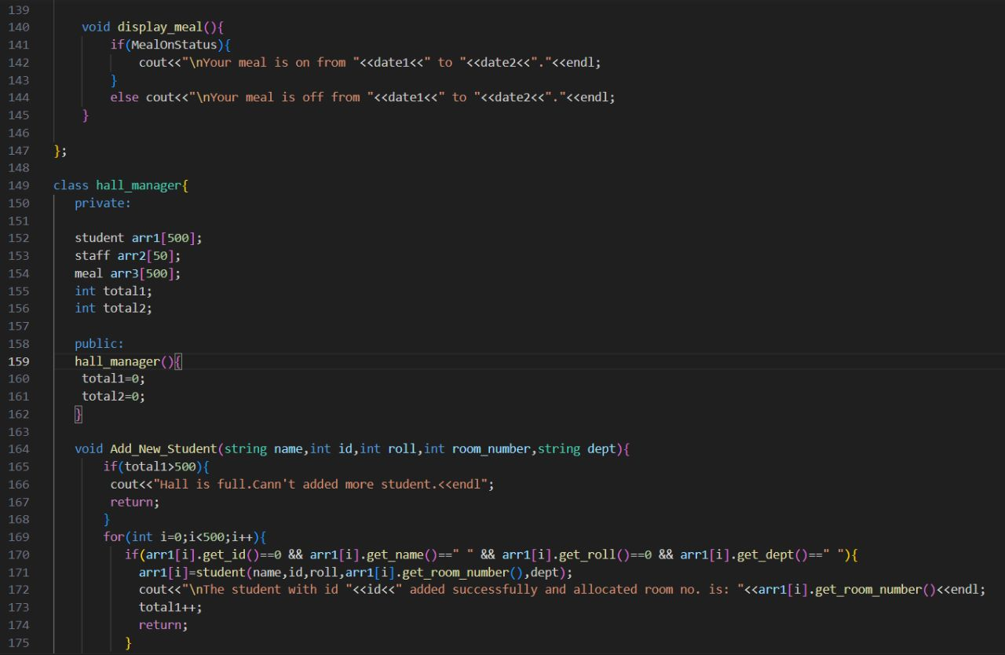
Class 4

Slide 32
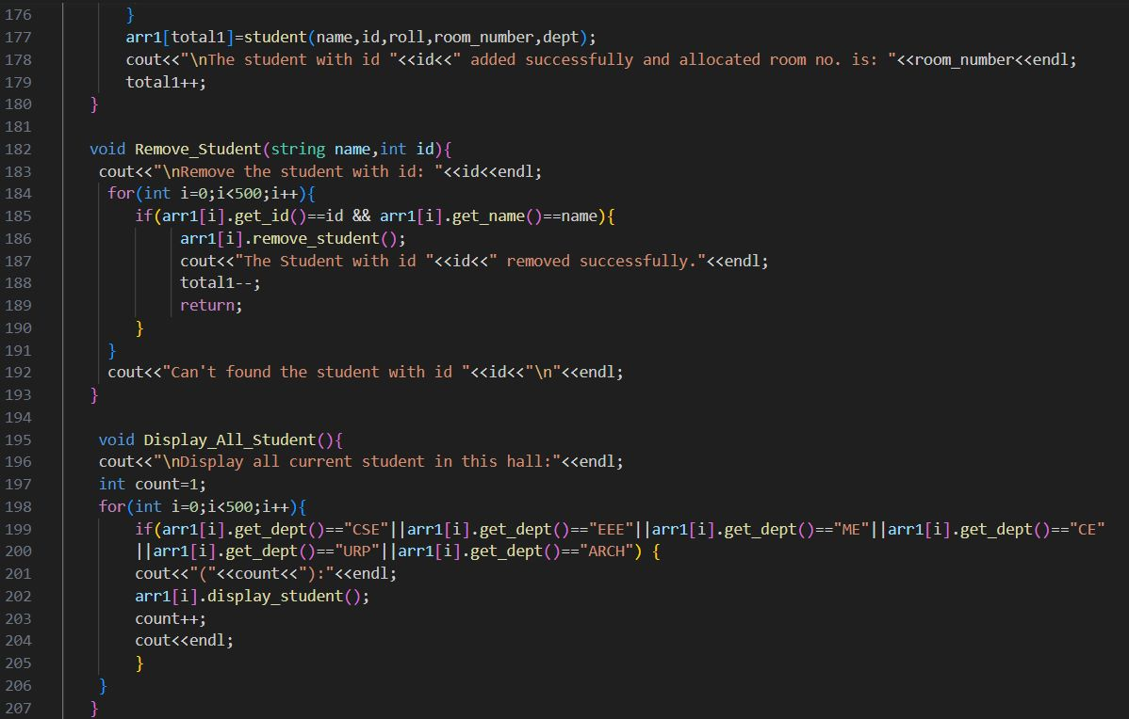

Slide 33
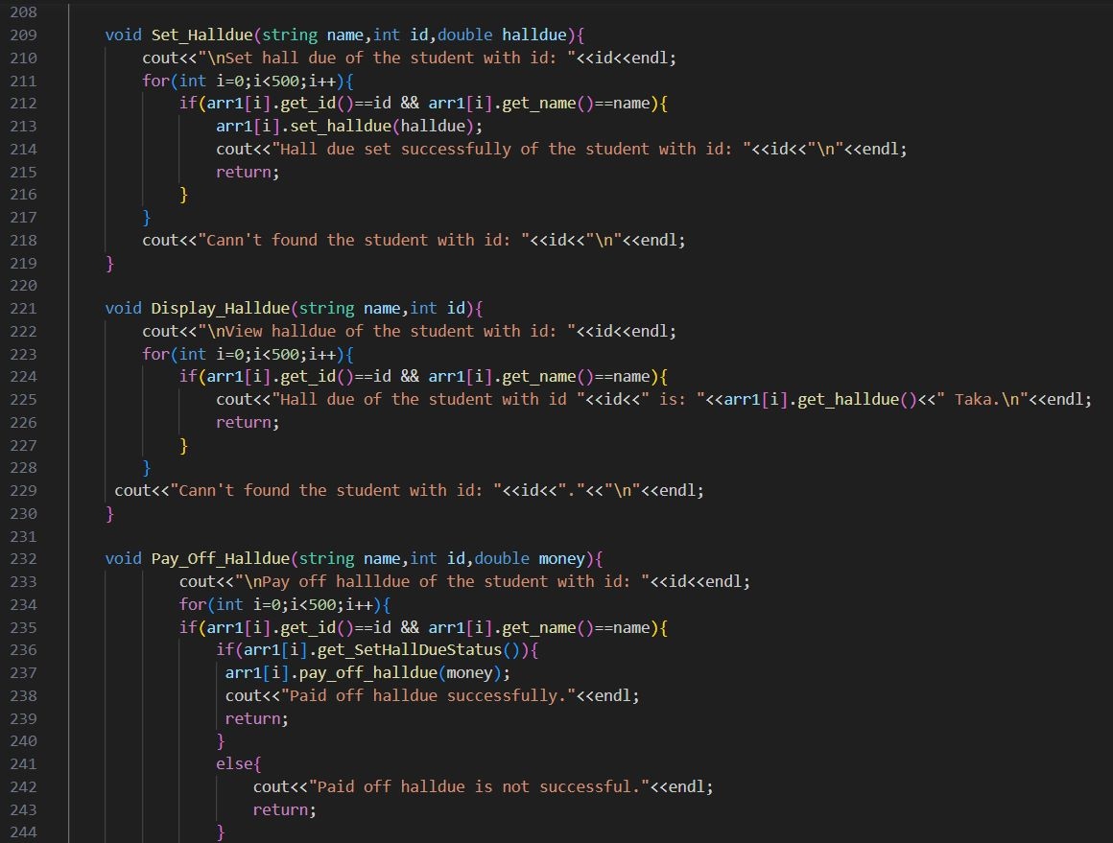

Slide 34
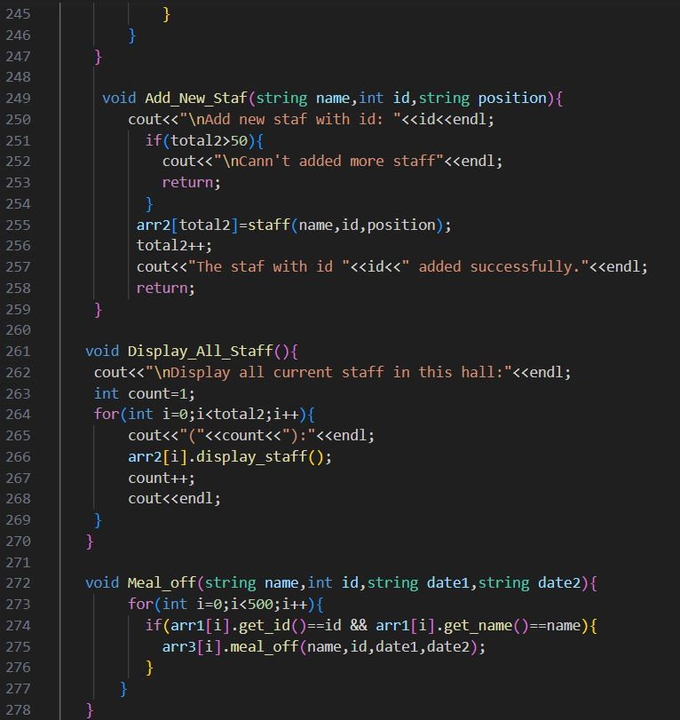

Slide 35
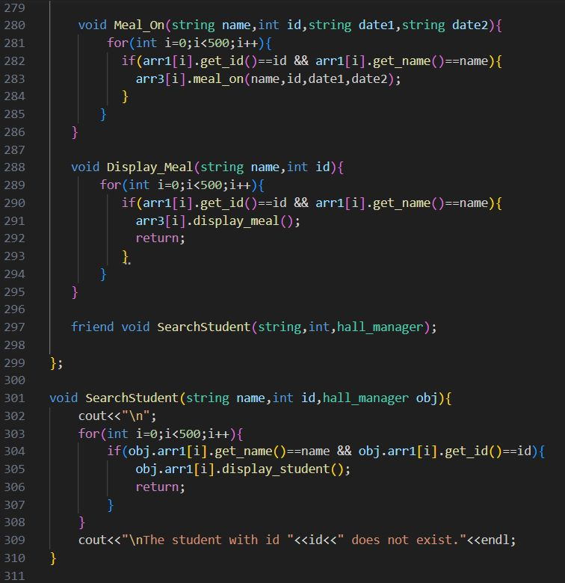
Friend Function

Slide 36
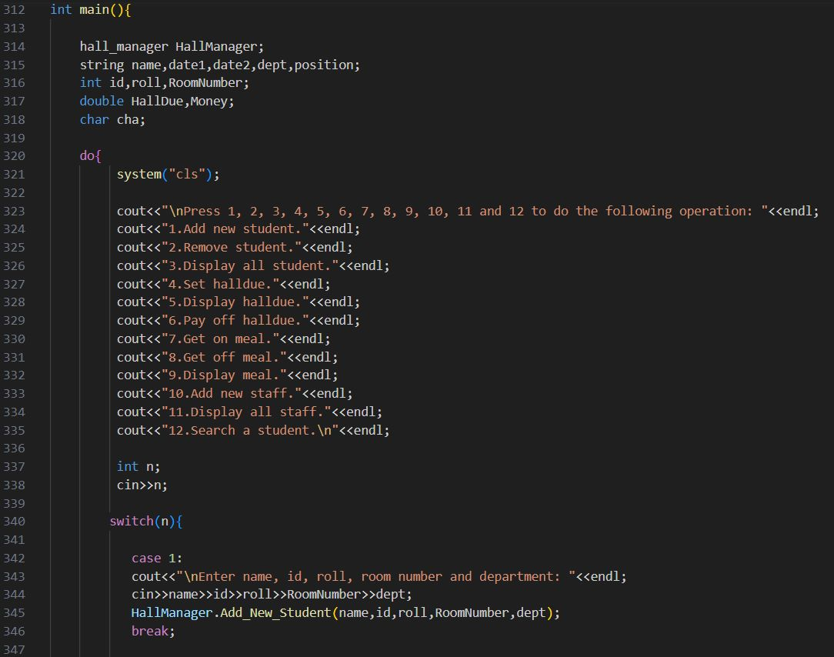

Slide 37
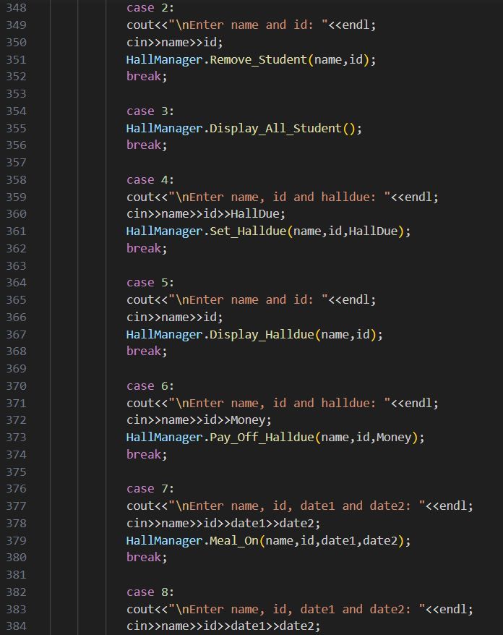

Slide 38
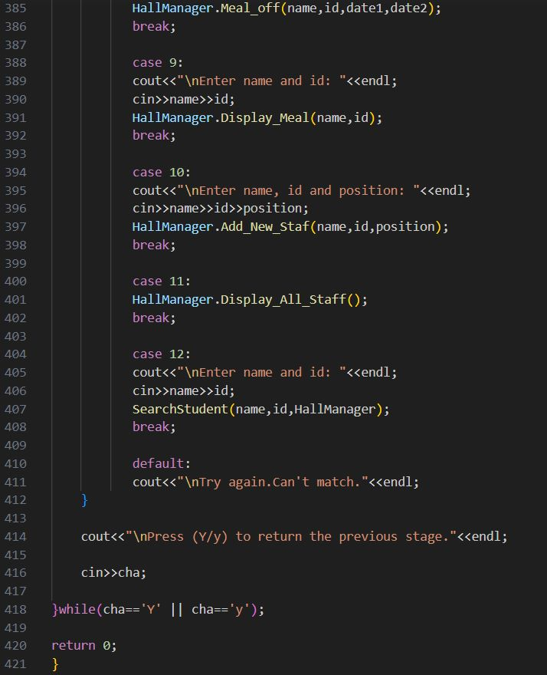

Slide 39
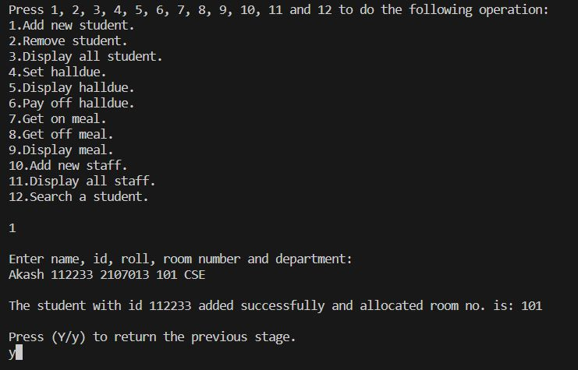
Output :

Slide 40
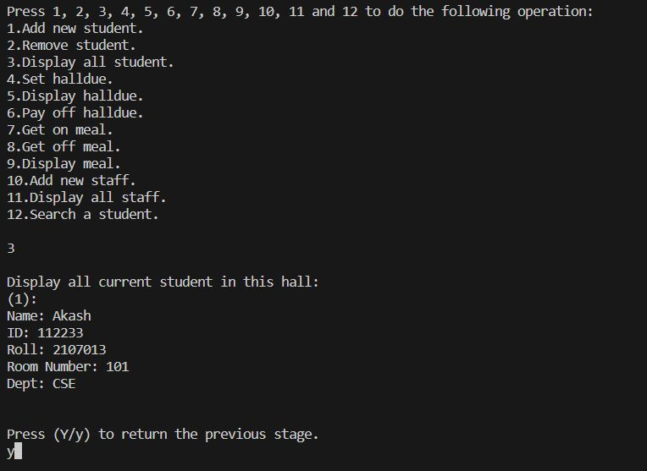

Slide 41
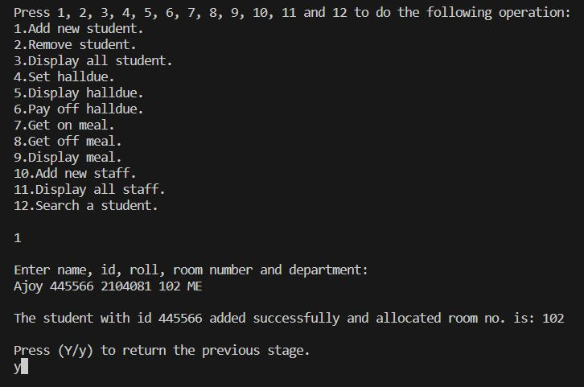

Slide 42
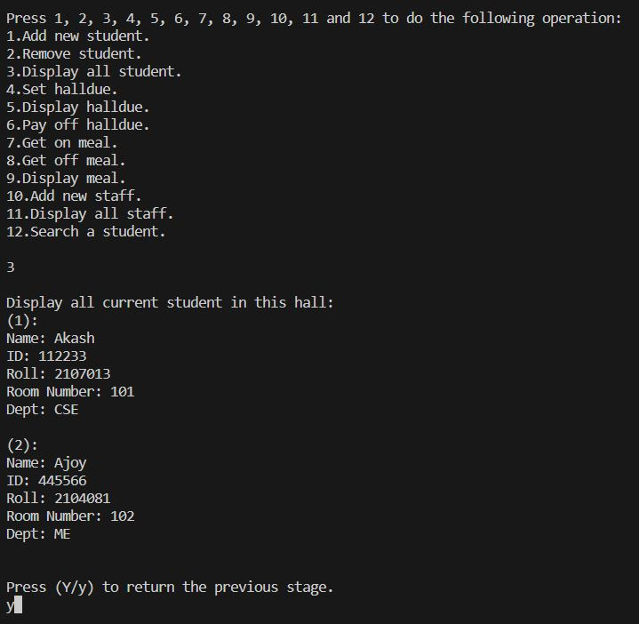

Slide 43
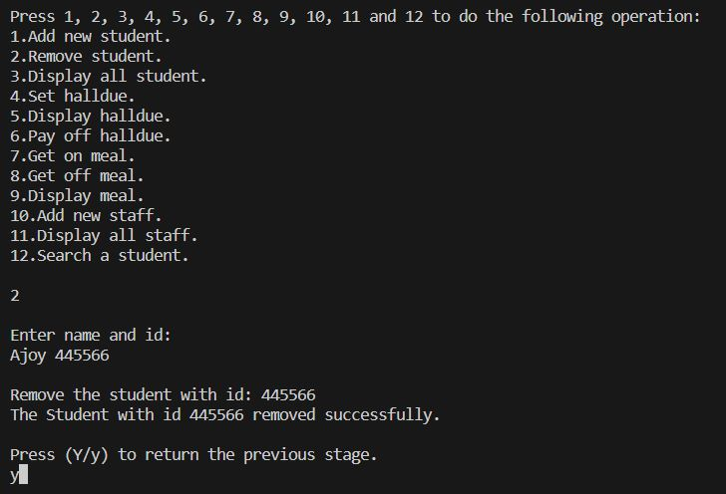

Slide 44
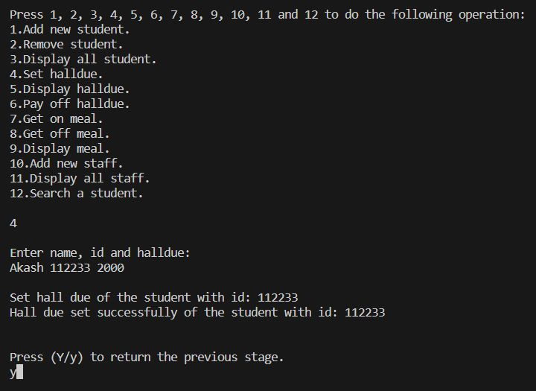

Slide 45
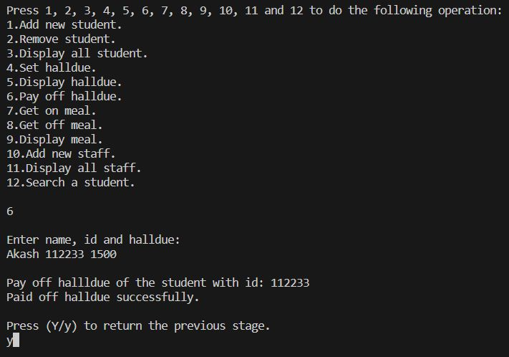

Slide 46
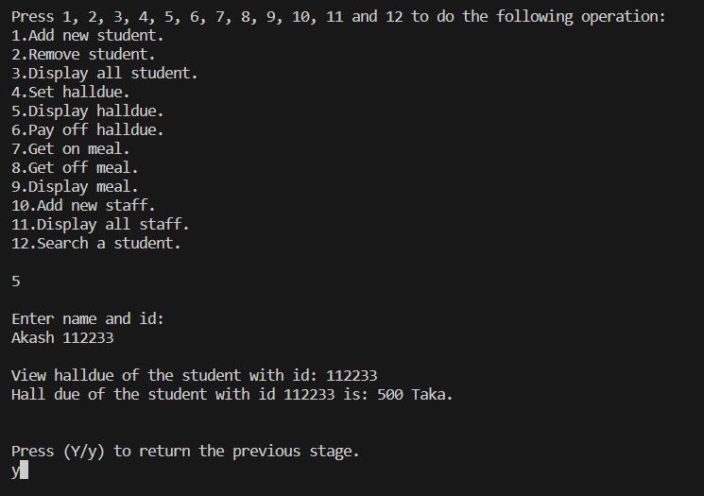

Slide 47
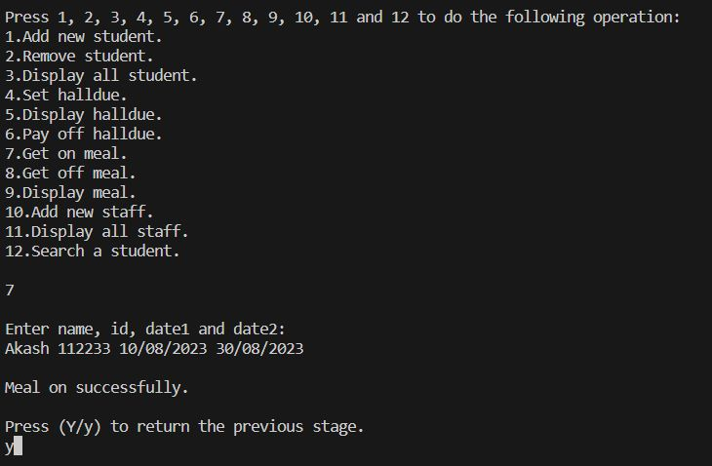

Slide 48
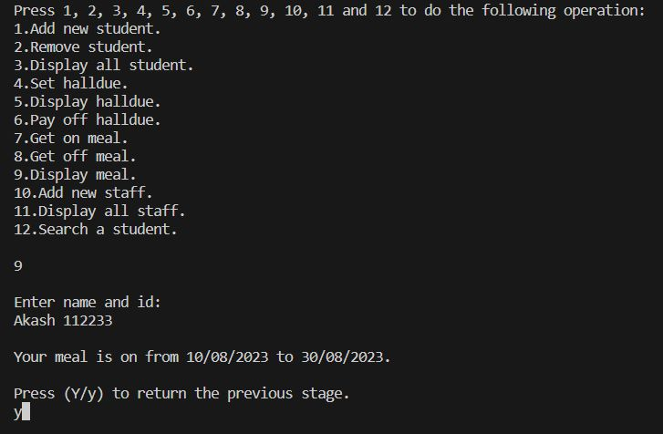

Slide 49
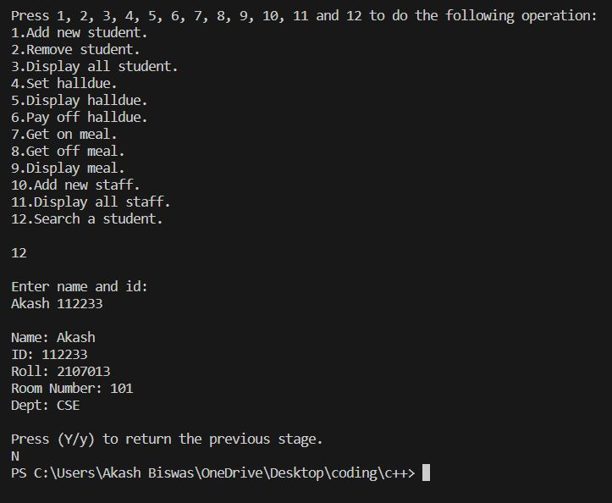

Slide 50
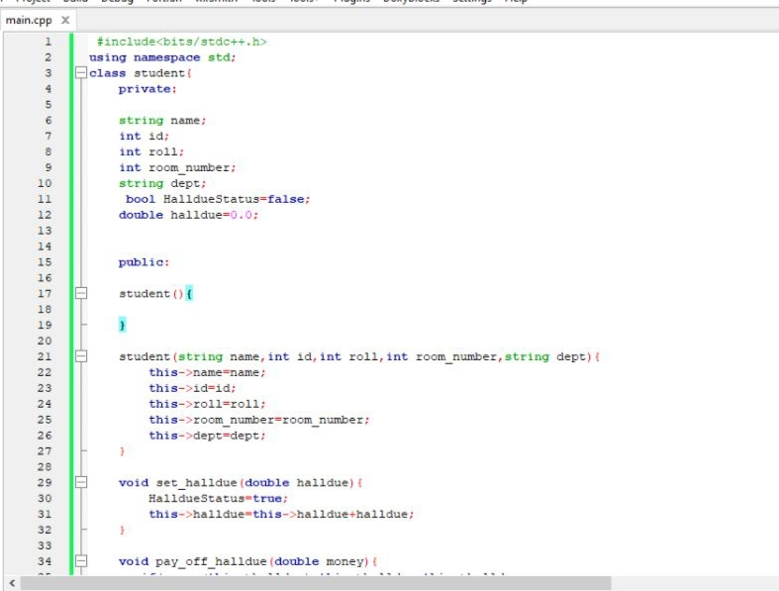
Code of 2107082 :
Class 1

Slide 51
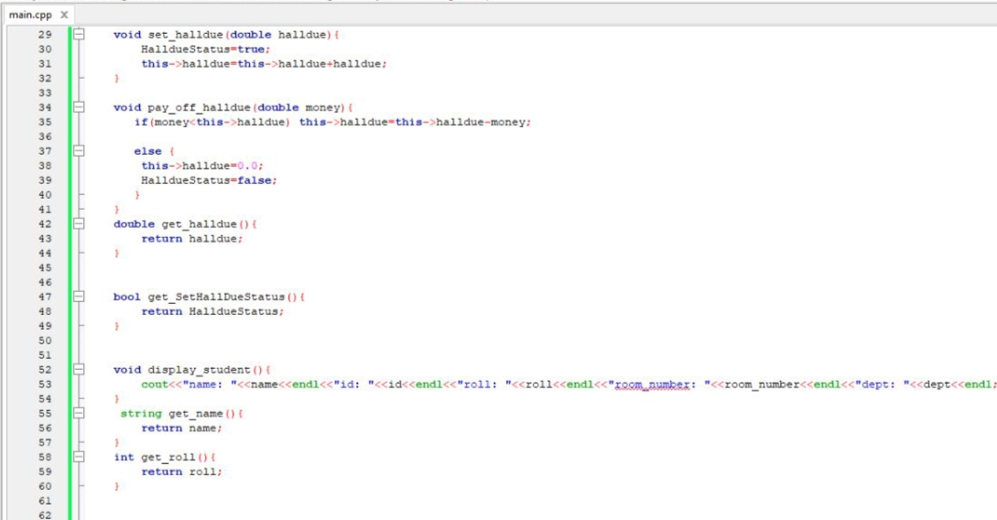

Slide 52
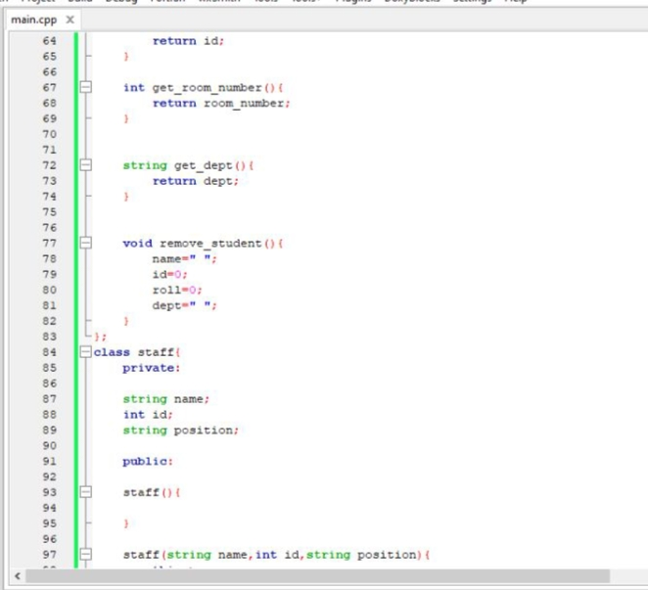
Class2

Slide 53
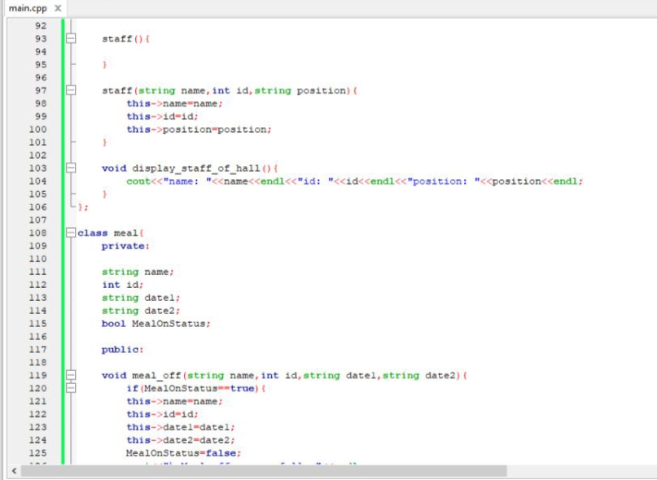
Class 3

Slide 54

Class 4

Slide 55


Slide 56


Slide 57


Slide 58


Slide 59

Friend Function

Slide 60


Slide 61


Slide 62


Slide 63

Output :

Slide 64


Slide 65


Slide 66


Slide 67


Slide 68


Slide 69


Slide 70


Slide 71


Slide 72
Thank you
SPECIAL THANKS TO OUR HONOURABLE SIR
SAFIN AHMMED
Lecturer , Department of CSE
Khulna University of Engineering & Technology, Khulna

